Slide 1
The Market Module
This section will introduce you the market simulation module.

Slide 2
What is the market module?
Integrates a seller/buyer price interaction and resolution capability
Provides an auction object to resolve clearing prices for supply and demand
Provides basic function to submit bids for services or demands into the market

Slide 3
Market – Basic Idea
Bids submitted by two primary types
  Suppliers – bid in amount they can provide and what they want to charge for it
  Demanders – bid in amount they wish to use and how much they are willing to pay for it
Market closes and “clears”
  Bidding process is stopped
  Supply and demand bids are arranged
  Meeting point of the two curves is the “clearing price and quantity” of the auction

Slide 4
Market – Simple Example
Consider a generation and demand scenario
  Generator A can produce 3 kW-h for $0.50 / kW-h
  Generator B can produce 1.5 kW-h for $0.90 / kW-h
  Load A wants 2.5 kW-h for a max of $0.60 / kW-h
  Load B wants 1.0 kW-h for a max of $0.80 / kW-h
What’s the final market clearing price and quantity?

Slide 5
Market – Simple Example
Generation
Bid into the Market
Load
P
2
P
1
1
P
2
Q
Q
Q
Clear the Market
Final Clearing Price and Quantity
P
P
Q
Q
Notes:
This slide is animated! See its awesomeness!

Slide 6
Market – How can it clear?
Discrete buying and selling blocks lead to four general cases for clearing the market
  Dependent upon the cross-over behavior of the discrete buying and selling blocks
  Variety of special cases can be classified within the general cases
  Some specific cases may lead to an irresolvable market
  Buying bids are sorted by descending price, while selling bids are sorted ascending
  Cases may contain various levels of responsive and non-responsive load

Slide 7
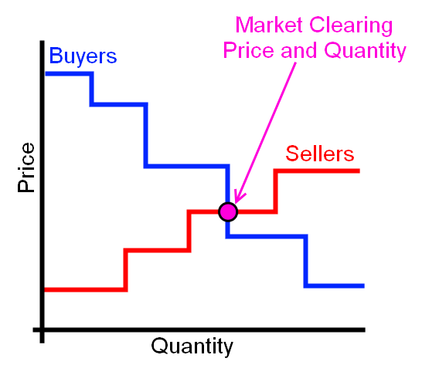
Market – How can it clear?
Marginal Seller case

Slide 8
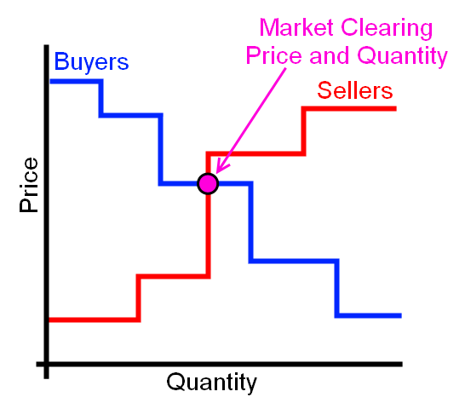
Market – How can it clear?
Marginal Buyer case

Slide 9
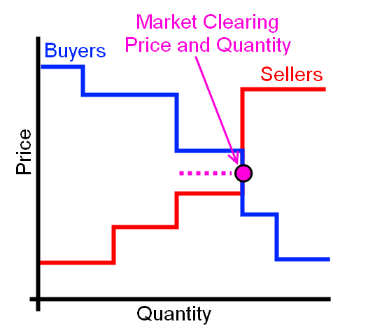
Market – How can it clear?
Seller and Buyer Quantity equal
P_{clear} = ½ * (Bid_{seller} + Bid_{price})

Slide 10
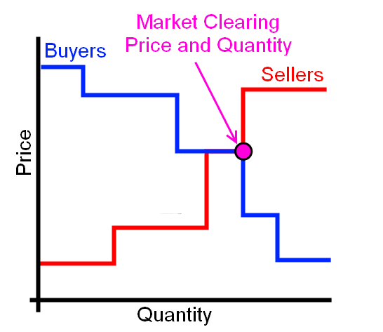
Market – How can it clear?
Seller and Buyer Quantity and Price equal

Slide 11
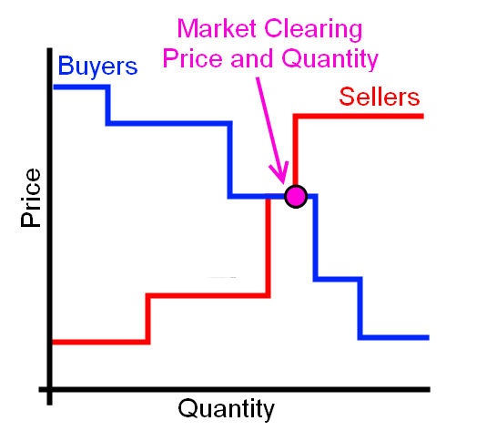
Market – How can it clear?
Marginal Buyer - special case

Slide 12
Market Objects
Auction object
  Collects and processes bids
  Clears market price and quantity
  Measures and stores market statistics
Controller objects
  Interface with loads and generators
  Performs bid and price response functions
  Has various control methods

Slide 13
Auction Objects
object auction {
string name;
string unit;
integer period[s];
integer latency[s]; //Lag between clearing and delivery
integer statistic_interval_x[s];
string special_mode; //Allows for buyer or seller only
double pricecap; //Maximum bid price allowed
boolean verbose; //Allows user to watch bidding
}
Defines market intervals
Provides clearing price and quantity after clearing, average prices, and standard deviation
Allows for active bidding from buyers and sellers

Slide 14
Auction Objects
object stubauction {
string name;
string unit;
integer period[s];
integer statistic_interval_x[s];
boolean verbose;
}
Defines market intervals
Provides clearing prices, averages, and standard deviations
Provides a non-biddable price signal

Slide 15
Bidding Function
Once an auction has been established, objects can submit bids
submit_bid function
  Market to bid into
  Object that is bidding
  Quantity to bid
  Price of bid

Slide 16
Clearing of the Market
Previous values stored in last.P and last.Q
Current cleared values stored in next.P and next.Q
Output values seen via recorder or directly to a controller object
Check cleared price/quantity manually or with another object

Slide 17
Controller Objects
object controller {
string control_mode; //RAMP or DOUBLE_RAMP
string market; //Name of auction object to be used
string parent; //Object modified by controller
string setpoint; //Set point to be modified by controller
string base_setpoint;//Desired set point value
string target; //Value set point is compared against
integer period[s];
string demand; //Bid quantity of object
boolean verbose;
string simple_mode; //Various “easy” connections to appliances
property average_target;
property standard_deviation_target;
…
}
Provides an interaction point between loads and market
Uses various external inputs to determine a bid_quantity and bid_price for the object it is attached to

Slide 18
Controller Objects - Ramp
object controller {
…
control_mode RAMP;
double range_low;
double range_high;
double ramp_low;
double ramp_high;
double slider_setting_heat; //Simple pre-set slider 0-100%
double slider_setting_cool; // participation in market
}
Control mode is dependent upon the object to be controlled
Determines how the object bids and how it responds to a specific price
RAMP mode controls thermostatic set points

Slide 19
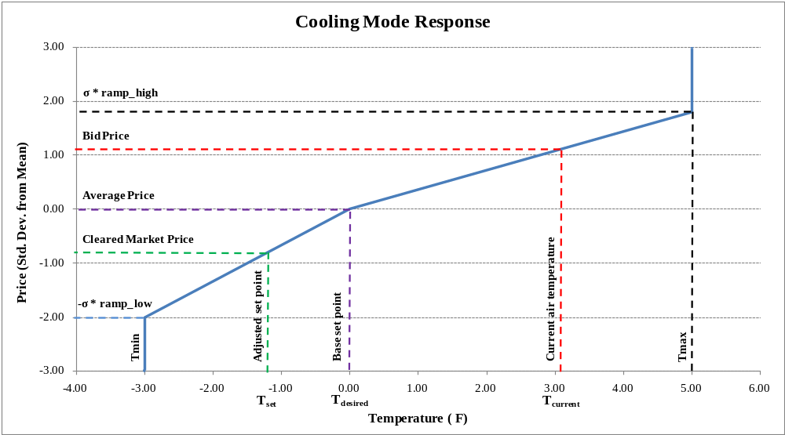
Controller Objects - Ramp

Slide 20
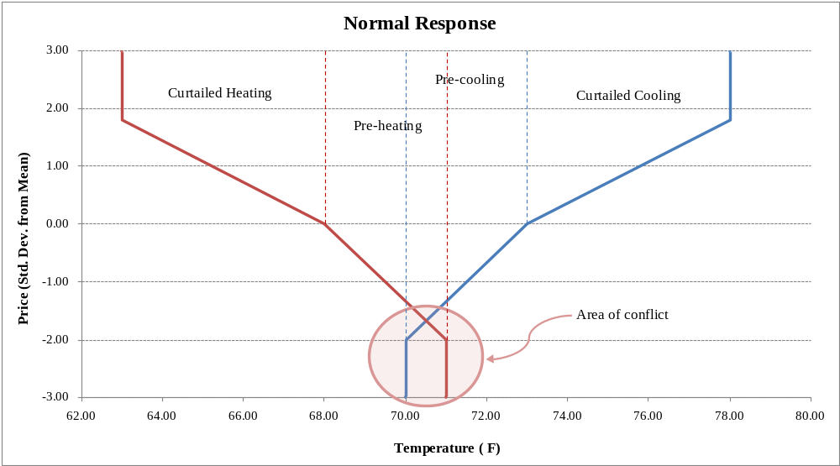
Controller Objects – Double Ramp
Normal action could cause conflicting pre-cooling and pre-heating states
DOUBLE_RAMP provides two means for resolving this conflict (deadband and sliding)

Slide 21
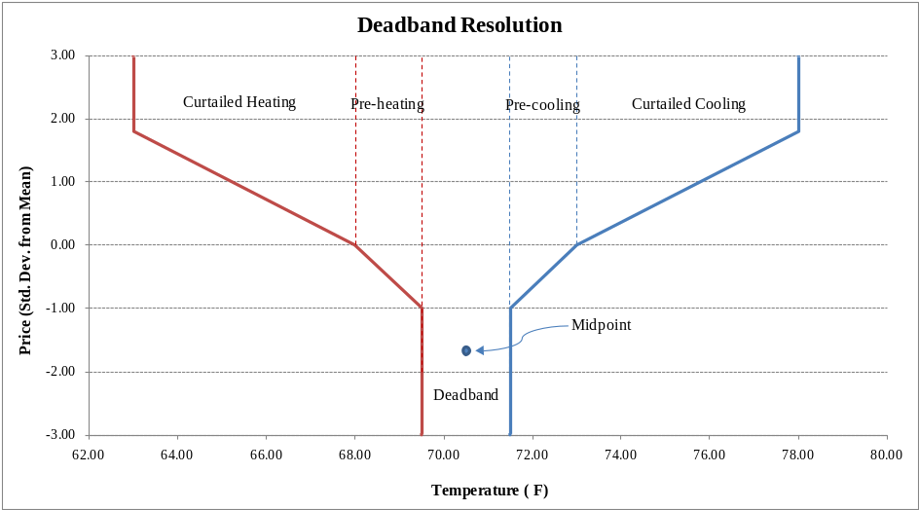
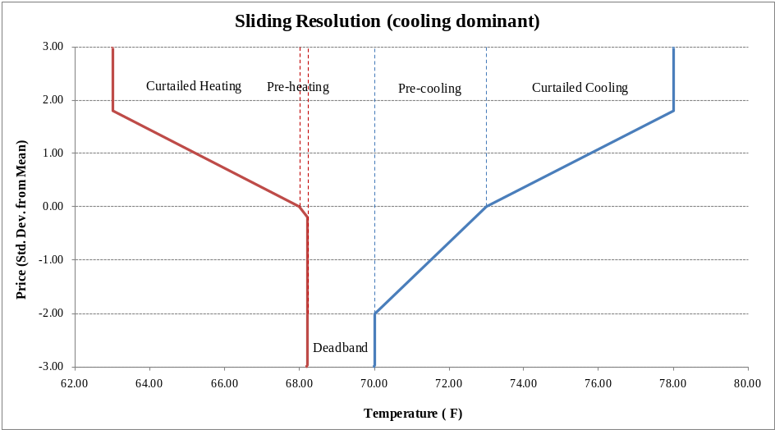
Controller Objects – Double Ramp
deadband resolution essentially limits the range of the pre-cooling and pre-heating and determines an average amount
sliding resolution determines which mode (heat or cool) was last used, and allows this to override the other

Slide 22
Controller Objects – Passive
object controller2 {
string control_mode; //RAMP, PROB_OFF, or DUTY_CYCLE
string setpoint; //Set point to be modified by controller
string base_setpoint;//Desired set point value
integer period[s];
object expectation_object; //Defines “average” value
property expectation_property;
object observation_object; //Defines observed value to be
property observation_property; //compared to “average” value
property stdev_observation_property;
property state_property;//Tracks the current state of object
enum distribution_type; //PROB_OFF only
double comfort_level; //PROB_OFF only
double range_high & range_low; //RAMP and DUTY_CYCLE
double ramp_high & ramp_low; //RAMP and DUTY_CYCLE
}
Only responds to a control signal – does not bid into the market
Can respond to non-price related signals
Typically used in conjunction with stub_auction

Slide 23
Exercises
Using the runtime object, “test”, located in the demo folder for this section:
  Create three buyers and sellers.
  Using schedules or players for the prices and quantities, create the various clearing cases with the bidding objects.
  Record the resulting market clearings.

Slide 24
Exercises
Using stubauction and a passive controller object with a Time-of-Use price signal, record the temperature setpoints for a single house.

